Slide 1


Missing Substance Detection
TIFR Project
Project Mentors:
Mrs. Priya R L
Dr. Sharmila Sengupta
Group Members:
56 - Tanay Phatak
67 - Tanmay Thakare
71 - Gautam Wadhwani
09 - Sakshi Bhojwani
Group Number : 29
Date: 26/01/2024

Slide 2
Content
Project Objective
Modular Diagram
Progress
OCR and Deskewing
Car Color Recognition
Car Model Identification
Future Work Plan
Re-Identification

Slide 3
Project Objective
Substance: Cars
Data Source: CCTV footage
Recent Focus: Model and Color of Cars, and Number Plate Recognition
Notes:
Tanmay

Slide 4
Progress
Progress so far:
Object detection and frame cropping.
Deskewing of number plate image for better OCR.
Number Plate Recognition using EasyOCR.
Car color recognition.
Car model identification.
Notes:
Mention 2 points: image overlaps and blur image similarity

Slide 5
OCR and Deskew
EasyOCR
EasyOCR is an open-source OCR library with robust language support, enabling seamless extraction of text from images in various scripts.
We tested EasyOCR on unprocessed cropped number plate images and then on deskew images.
Deskew
Performed deskewing using OpenCV functions like HoughLinesP and getRotationMatrix2D to automatically detected the amount of rotation required and perform the required processing.

Slide 6




OCR and Deskew
Deskewing Results (using OpenCV):
Original image
Deskew image
OCR Results on original image
OCR Results on deskew image

Slide 7
Car Model Identification
EfficientNet B1 Model
EfficientNet uses a technique called compound coefficient to scale up models in a simple but effective manner.
Instead of randomly scaling up width, depth or resolution, compound scaling uniformly scales each dimension with a certain fixed set of scaling coefficients.
Dataset: It contains 4000 images of two of the popular cars (Swift and WagonR).
Theory of EfficientNet B1 Model

Slide 8
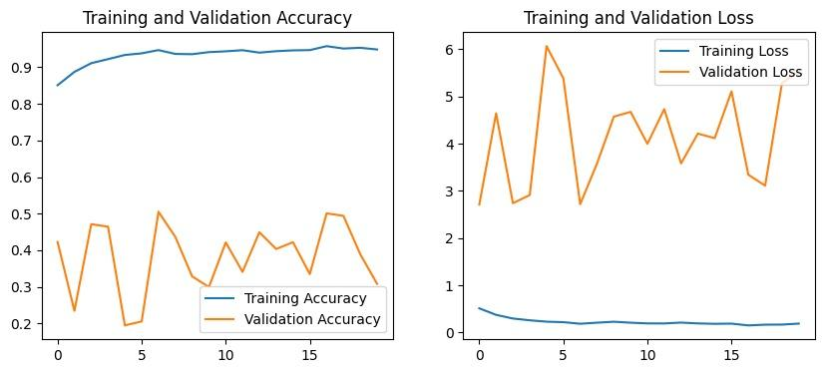
Car Model Identification
Model performance on Dataset-1 of 196 Classes

Slide 9
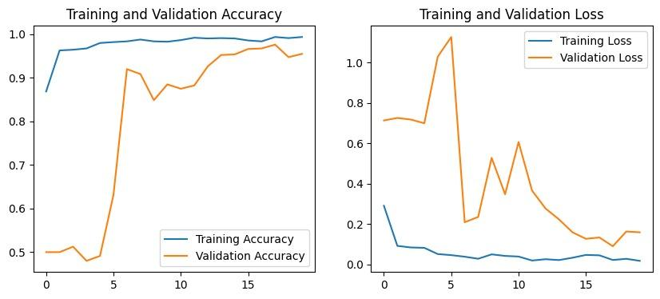
Car Model Identification
Model performance on WagonR-Swift dataset

Slide 10
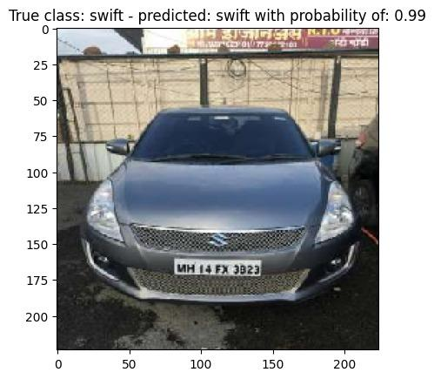
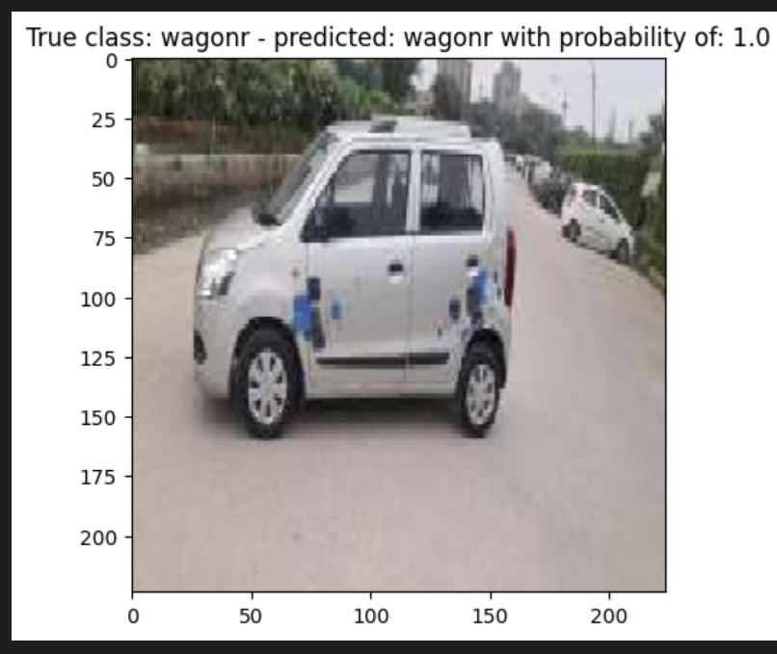
Car Model Identification
Testing Dataset Images

Slide 11
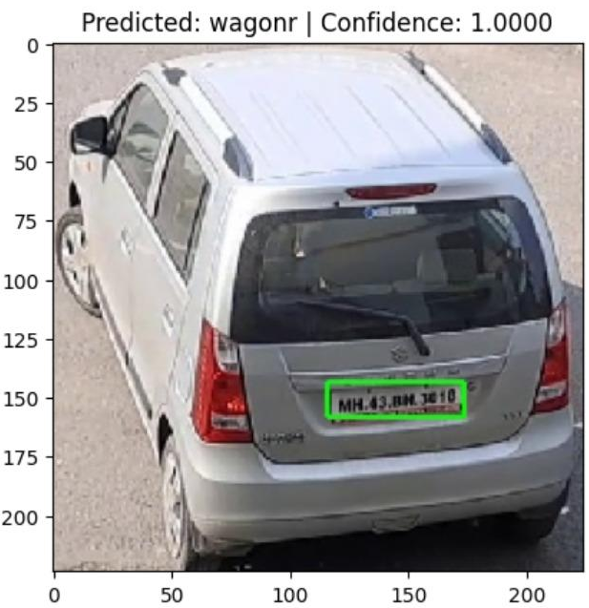
Car Model Identification
Test on video frame

Slide 12
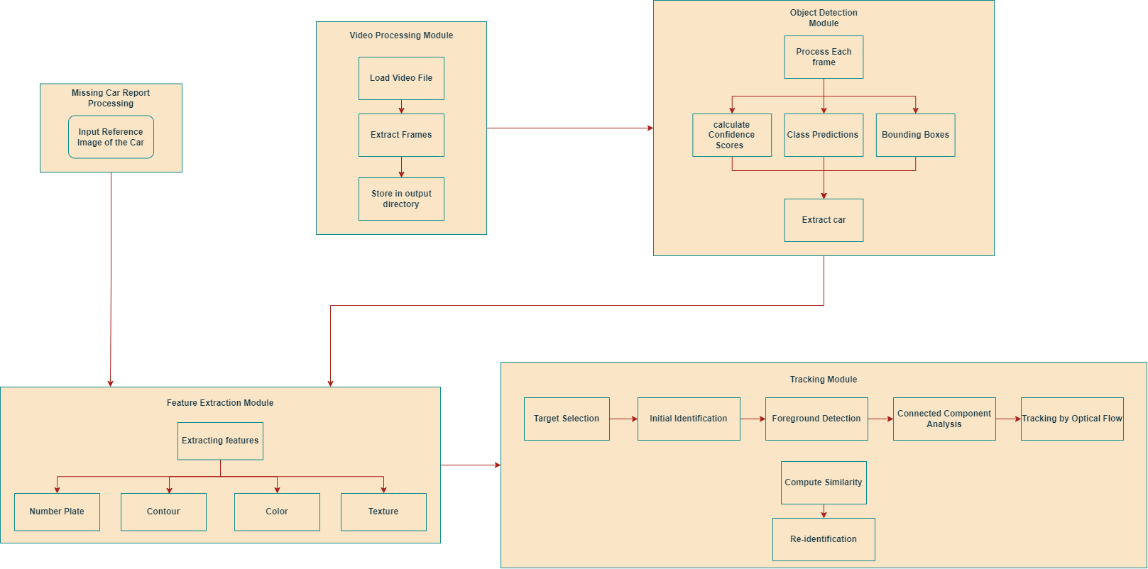
Modular Diagram

Slide 13
Future Work Plan
Next we plan to do the following:
Perform car tracking using algorithms like SORT and DeepSORT.
Perform car re-identification using deep learning models like Siamese Networks trained on reid datasets like VeRi, etc.
Create an interactive interface using Pyqt and sqlite.
Further, we try to explain the importance of re-identification to this project.

Slide 14
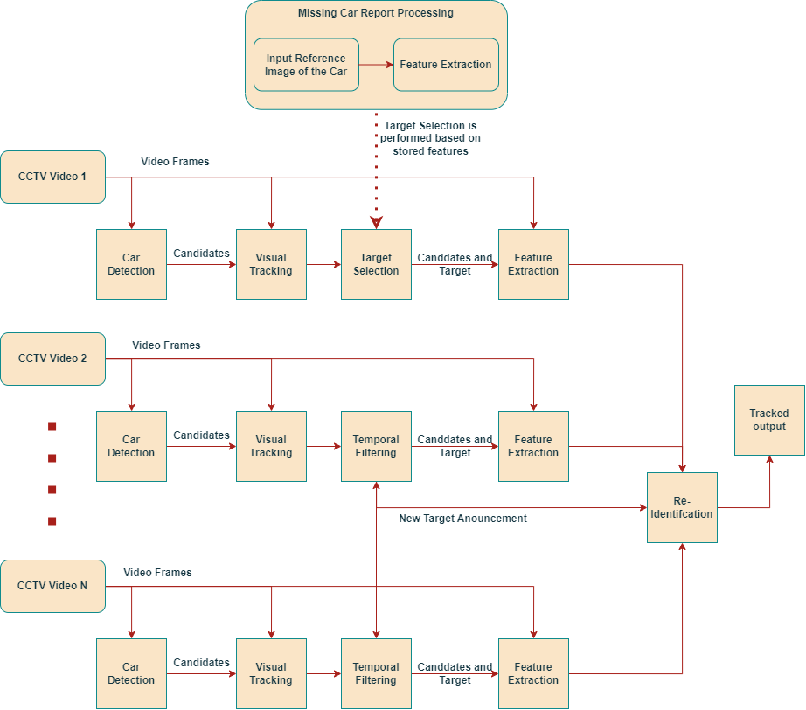
Re-Identification and Tracking

Slide 15
Thank You

